Slide 1
Just Spring
Dang Thi Thao My

Slide 2
Content
Spring
Basics
Beans
Concepts
Data

Slide 3
Spring Basics
Dependency Injection
Designing to Interfaces
Type Injection
Property File

Slide 4
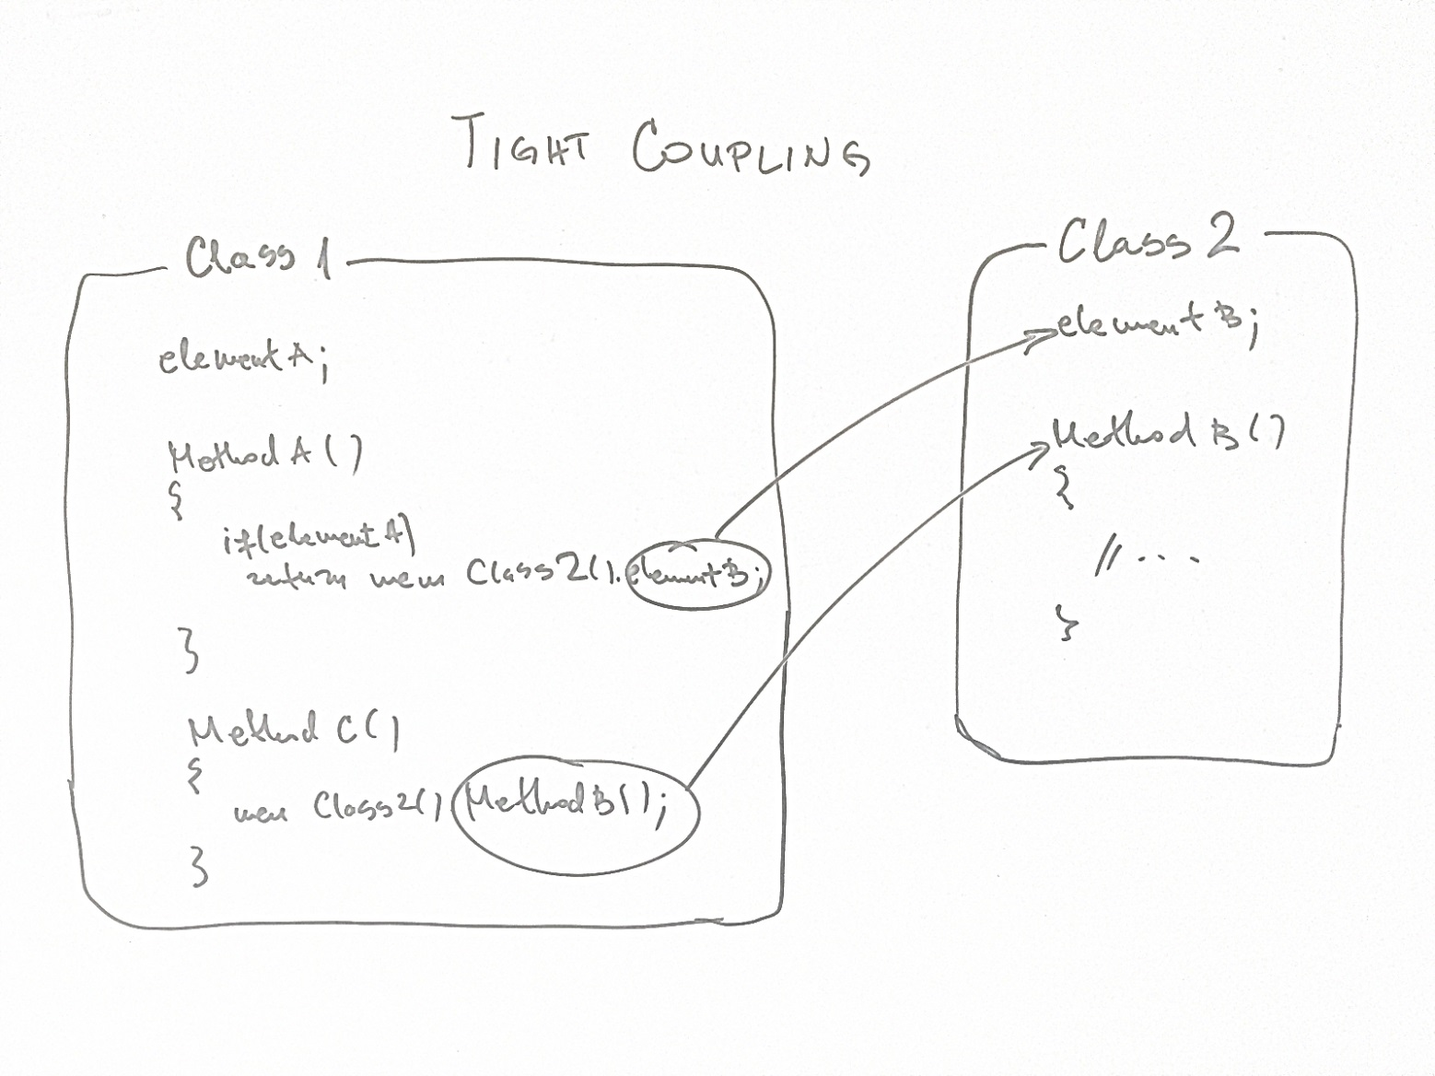
Spring Basics Dependency Injection
Object Coupling Problem: cannot change Class 2 without refactor Class 1

Slide 5
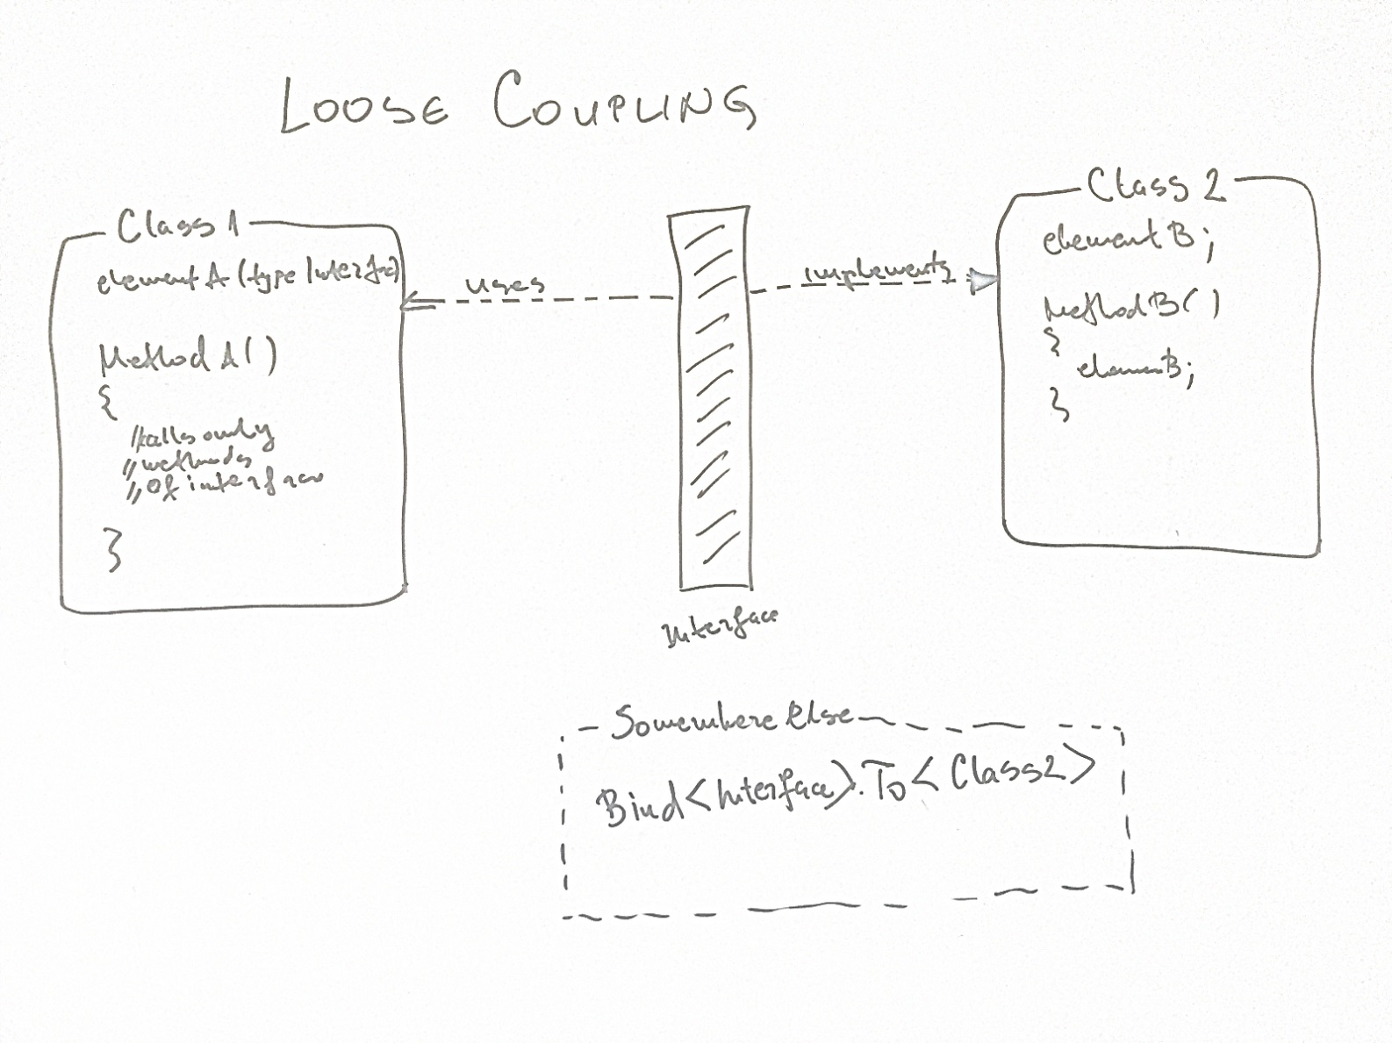
Spring Basics Dependency Injection
Object Coupling Problem => Design to interfaces

Slide 6
Spring Basics Designing to Interfaces
Reader interface
Implementation:
FileReader
DatabaseReader
FtpReader

Slide 7
Spring Basics Designing to Interfaces
DataReaderClient
takes the interface Reader
does not know where it is fed data until runtime - Polymorphism

Slide 8
Spring Basics Designing to Interfaces
DataReaderClient
How can we provide an instance of Reader to DataReader without hardwiring?
Dependency Injection (DI) framework => Spring
DI ⬄ Inversion of Control (IoC)

Slide 9
Spring Basics Designing to Interfaces
ClasspathXmlApplicationContext passes and XML file
ApplicationContext creates the container consisting of the objects defined in the XML file.

Slide 10
Spring Basics Designing to Interfaces
FileReader is a bean having a unique name fileReader
Use API of Context to access all beans defined in the XML

Slide 11
Spring Basics Designing to Interfaces
Create a concrete Reader implementation, the FileReader as a simple POJO.
Create the XML file to configure this bean.
Create a container with this bean in the client by reading the XML file.
Query the container to obtain the bean, then invoke the respective methods.
=> create Service layer glued to the client

Slide 12
Spring Basics Designing to Interfaces
ReadService is an interface between the client and the Reader.

Slide 13
Spring Basics Designing to Interfaces
ReadService is an interface between the client and the Reader.
The client will only know the Service
fetchData() delegates the call to the respective implementation
Don’t talk to strangers!

Slide 14
Spring Basics Designing to Interfaces
Wire the ReaderService with Reader in reader-beans.xml

Slide 15
Spring Basics Designing to Interfaces
Wire the ReaderService with Reader in reader-beans.xml
ApplicationContext reads the file and instantiates ReaderService and FileReader.

Slide 16
Spring Basics Designing to Interfaces
The client will only have knowledge of the service – no Readers whatsoever.

Slide 17
Spring Basics Type Injection
Constructor Type Injection – A constructor that takes the arguments, and these arguments are wired via the config file.

Slide 18
Spring Basics Type Injection
Setter Type Injection – the FW checks the reader property in bean readerService and setReader(fileReader) will be invoked.

Slide 19
Spring Basics Type Injection
Mixing Constructor and Setter
the componentName is initialized using constructor
filename is set via setter

Slide 20
Spring Basics Property Files
How to avoid the hard-coded properties in the XML file (FtpReader)?
=> reader-beans.properties

Slide 21
Spring Basics Property Files
Add PropertyPlaceholderConfigurer to the read-beans.xml file
Parameterize the FileReader property.

Slide 22
Spring Beans
XML Configuration
Life Cycle

Slide 23
Spring Beans XML Configuration
Beans – Object instances
Class definitions form the Configuration metadata.
Multiple XML files: business-beans.xml, util-beans.xml, dao-beans.xml
File name: No naming convention, but should be two parts separated by hyphen.
Bean name: camelCase

Slide 24
Spring Beans Life Cycle
The framework factory loads the bean definitions and creates the bean.
Interfaces: BeanNameAware, BeanFactory Aware
Pre-initialization: invokes BeanPostProcessor
Init-method is invoked on the bean
Post-initialization

Slide 25
Spring Beans Life Cycle
The factory reads the definition
Creates the class using Java Reflection
Injects the property filename by invoking setFileName() with the value in myfile.txt
The bean is ready to used

Slide 26
Spring Beans Life Cycle
If FileReader bean has a dependency on another bean, the other bean will be created
FileRead is injected with a location object

Slide 27
Spring Beans Life Cycle
Method Hooks
Init-method
Destroy-method

Slide 28
Spring Beans Life Cycle
Bean Post Processors (not recommend)

Slide 29
Spring Beans Life Cycle
Bean Scopes
Singleton Scope (default) – need one and only one instance
Spring Singleton – a singleton per container
Java Singleton – a singleton per process or class loader
Prototype Scope – create a new instance every time a call is made

Slide 30
Spring Beans Property Editors
Injecting Java Collections
using properties – java.util.Properties
using Lists, Sets and Maps – java.util.List/Map

Slide 31
Spring Beans Property Editors
Injecting Java Collections
using properties – java.util.Properties
using Lists, Sets and Maps – java.util.List/Set/Map

Slide 32
Spring Beans Property Editors
Injecting Java Collections
using properties – java.util.Properties
using Lists, Sets and Maps – java.util.List/Set/Map

Slide 33
Spring Concepts Containers
Two categories:
BeanFactory – simple container supporting DI
Implementation XmlBeanFactory
Small device application
ApplicationContext – extension of BeanFactory
FileSystemXmlApplicationContext
ClassPathXmlApplicationContext
WebXmlApplicationContext

Slide 34
Spring Concepts Instantiating Beans
Constructor (discussed)
Using Static Methods
Using Factory Methods

Slide 35
Spring Concepts Instantiating Beans
Using Static Methods

Slide 36
Spring Concepts Instantiating Beans
Using Factory Methods

Slide 37
Spring Concepts Bean Post Processors
Alter the configuration before the final call
BeanPostProcessor interface
postProcessBeforeInitialization()
postProcessAfterInitialization()

Slide 38
Spring Concepts Event Handling
Notification
ApplicationContext
ContextStartedEvent
ContextStoppedEvent
Others

Slide 39
Spring Concepts Event Handling
Listening to Context Events
Other events
ContextStartedEvent
ContextStoppedEvent
ContextRefeshedEvent
ContextRefeshedEvent
RequestHandledEvent

Slide 40
Spring Concepts Event Handling
Publishing Custom Events

Slide 41
Spring Concepts Event Handling
Receiving Custom Events
Single Threaded Event Model

Slide 42
Spring Concepts Auto Wiring
Autowiring relationships and dependencies
Autowiring byName
Autowiring byType
Autowiring by Constructor
Mixing Autowiring with Explicit wiring

Slide 43
Spring Concepts Auto Wiring
Autowiring byName

Slide 44
Spring Concepts Auto Wiring
Autowiring byType
More than one bean with the same type – fatal exception

Slide 45
Spring Concepts Auto Wiring
Autowiring byConstructor

Slide 46
Spring Concepts Auto Wiring
Mixing Autowiring with Explicit wiring

Slide 47
Spring Data
Spring JDBC
Hibernate

Slide 48
Spring Data Spring JDBC
JDBCTemplate
SimpleJdbcTemplate
NamedParameterJdbcTemplate
ResultSet
PreparedStatementCallback- creating PreparedStatement
RowCallbackHandler – extract ResultSet into objects
CallableStatementCallback – executing a stored procedure

Slide 49
Spring Data Spring JDBC
Configuring JDBCTemplate

Slide 50
Spring Data Spring JDBC
Configuring JDBCTemplate

Slide 51
Spring Data Spring JDBC
Manipulating Data Using JdbcTemplate
queryForObject()
queryForInt()
queryForList()
queryForMap()

Slide 52
Spring Data Spring JDBC
Returning Domain Objects

Slide 53
Spring Data Spring JDBC
Returning Domain Objects

Slide 54
Spring Data Spring JDBC
Returning Domain Objects

Slide 55
Spring Data Hibernate
Mapping database columns to the objects by readinga configuration file.
“.hbm.xml”
HibernateTemplate – access the database

Slide 56
Spring Data Hibernate
Hibernate requires a Session object to access the database
Movie.hbm.xml

Slide 57
Spring Data Hibernate
HibernateTemplate requires a SessionFactory instance

Slide 58
Spring Data Hibernate
Methods for retrieving data

